Slide 1

APBD – lecture 7
ORM
EntityFramework Core

Slide 2
Object/Relational Mapping (O/RM) framework
Object–relational mapping (ORM, O/RM, and O/R mapping tool) in computer science is a programming technique for converting data between incompatible type systems using object-oriented programming languages.
This creates, in effect, a "virtual object database" that can be used from within the programming language. There are both free and commercial packages available that perform object–relational mapping, although some programmers opt to construct their own ORM tools.

Slide 3
Entity Framework Core
Entity Framework Core is the new version of Entity Framework after EF 6.x. It is open-source, lightweight, extensible and a cross-platform version of Entity Framework data access technology.
Entity Framework is an Object/Relational Mapping (O/RM) framework. It is an enhancement to ADO.NET that gives developers an automated mechanism for accessing & storing the data in the database.

Slide 4
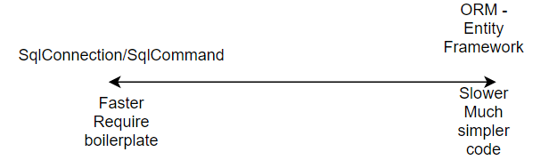
Entity Framework Core

Slide 5
EF Core Development Approaches
EF Core supports two development approaches
1) Code-First
2) Database-First.
EF Core mainly targets the code-first approach and provides little support for the database-first approach because the visual designer or wizard for DB model is not supported as of EF Core 2.0.

Slide 6
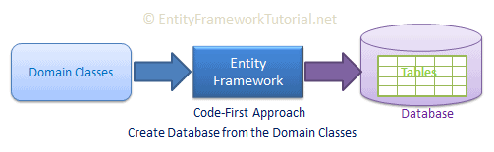
Code first
In the code-first approach, EF Core API creates the database and tables using migration based on the conventions and configuration provided in your domain classes. This approach is useful in Domain Driven Design (DDD).

Slide 7
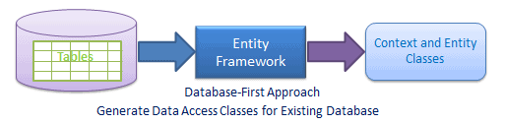
Database first
In the database-first approach, EF Core API creates the domain and context classes based on your existing database using EF Core commands. This has limited support in EF Core as it does not support visual designer or wizard.

Slide 8
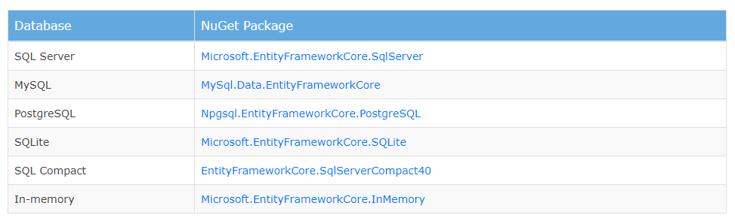
EF Core Database Providers
Entity Framework Core uses a provider model to access many different databases. EF Core includes providers as NuGet packages which you need to install.

Slide 9
EF Core - installation
EF Core is not available by default
We will need to install required libraries using Nuget package manager
Microsoft.EntityFrameworkCore – main package for EF Core
Microsoft.EntityFrameworkCore.SqlServer - db provider for MS SQL Server database

Slide 10
EF Core - tools
Microsoft.EntityFrameworkCore.Tools – Along with the DB provider package, you also need to install EF tools to execute EF Core commands.
These make it easier to perform several EF Core-related tasks in your project at design time, such as migrations, scaffolding, etc.
This will allow you to execute EF Core commands for scaffolding, migration etc. directly from Package Manager Console (PMC) within Visual Studio.

Slide 11
Database first approach
Database first approach is often used when the database we want to use already exists and we simply want to start communicating with it (mainly SELECT, INSERT, UPDATE, DELETE).
We usually don’t want to affect the structure of the database
In this scenario we assume that db developer is responsible for any changes to the database structure. We simply want to „use” the database.

Slide 12
Database first approach
To use this approach:
We could create all the necessary classes manually
We can generate all the necessary classes automatically using scaffolding. The generation read the metadata about our tables and generete classes based on that.

Slide 13
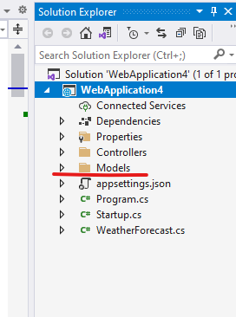
Scaffolding necessary classes
1. First its good to prepare yourself some kind of folder which we will use as the container for all the generated classes. Otherwise classes will be generated into the root of the project.

Slide 14
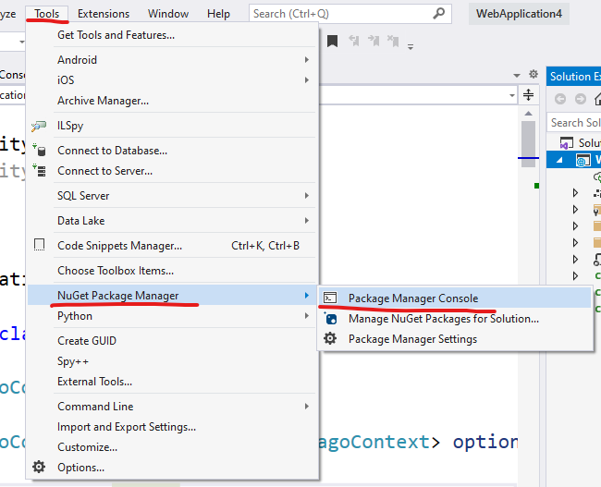
Scaffolding necessary classes
2. (for Visual Studio) open Tools -> NuGet Package Manager -> Package Manager Console

Slide 15
Scaffolding necessary classes
3. In the Package Manager Console run the following command.
Scaffold-DbContext "Data Source=db-mssql16.pjwstk.edu.pl;Initial Catalog=pgago;Integrated Security=True" Microsoft.EntityFrameworkCore.SqlServer -OutputDir Models -Tables "Client”,”Trip,”Client_Trip”,”Country”,”Country_Trip„
First parameter – represent your connection string
Second parameter – library used as the database provider
OutputDir – allows us to specify when we want to generate the required classes
Tables – allows us to choose which tables we are interested in (by default all the tables will be taken into account)

Slide 16
Scaffolding necessary classes
2.1 (in other IDEs) Open the terminal/console and run the following command:
dotnet ef dbcontext scaffold "Data Source=db-mssql16.pjwstk.edu.pl;Initial Catalog=pgago;Integrated Security=True" Microsoft.EntityFrameworkCore.SqlServer --output-dir Models --table Client --table Trip

Slide 17
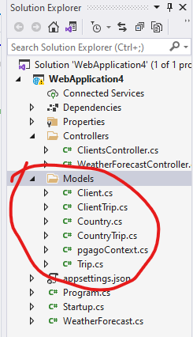
Result of scaffolding the classes
As a result of scaffolding the necessary classes we should get:
DbContext class – usually named after the name of the database
Model classes – one class per table from database

Slide 18
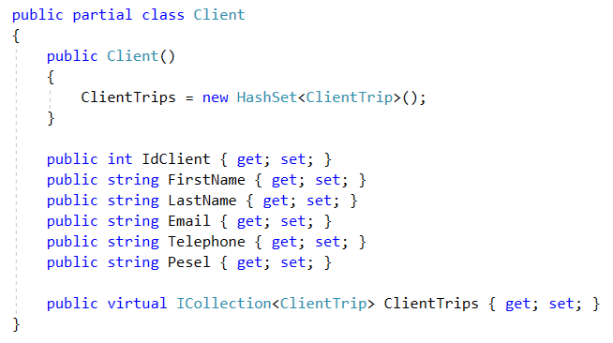
Model classes
Every class is mapped to the table in database

Slide 19
Model classes
partial – models are generated as partial classes. This mechanism allows us later to extend easily the functionality of the class (if needed).
public virtual ICollection<ClientTrip> ClientTrips
This collection represents a relations in the database. Each client can be assigned to many ClientTrips. In „objective world” it means that client can have multiple ClientTrips objects assigned to him.
virtual – this keyword means that this property can be overriden. This may be usefull when using lazy loading or other mechanisms.
ICollection<ClientTrip> - ICollection<T> is the most generic interface which allows us to add/remove elements from collection. (IEnumerable<T> does not specify those methods). In other words we are using the most generic interface we can.

Slide 20
DbContext
The DbContext class is an integral part of Entity Framework. An instance of DbContext represents a session with the database which can be used to query and save instances of your entities to a database.

Slide 21
DbContext
DbContext in EF Core allows us to perform following tasks:
Manage database connection
Configure model & relationship
Querying database
Saving data to the database
Configure change tracking
Caching
Transaction management

Slide 22
DbContext
To use DbContext in our application, we need to create the class that derives from DbContext, also known as context class. This context class typically includes DbSet<TEntity> properties for each entity in the model. Consider the following example of context class in EF Core.

Slide 23
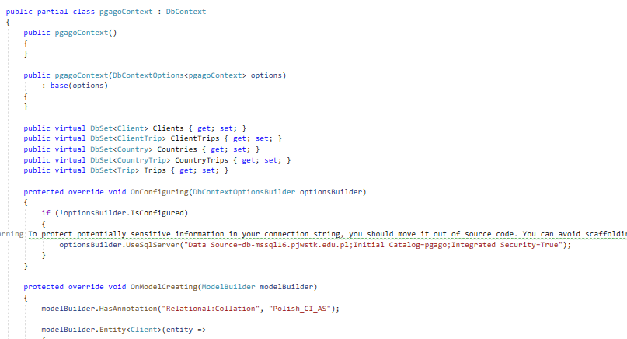
DbContext

Slide 24
DbContext
Change Tracking
The Change Tracker detects changes made to entities and sets the EntityState of an object accordingly. The state of the entity determines the type of operation that the database will be asked to perform upon it, and therefore the SQL that will be generated.
Model Building
The DbContext builds a conceptual model based on convention and configuration, and maps that to the database. The model and its mappings are built at application startup and are persisted in memory for the lifetime of the application.

Slide 25
DbContext
Data Mapping
The DbContext includes a data mapper layer responsible for mapping the results of SQL queries to entity instances and other types defined by the client application.
Object Caching
The DbContext provides a first-level cache for objects that it is asked to retrieve from the data store. Subsequent requests for the same object will return the cached object instead of executing another database request.
Transaction Management
When the DbContext SaveChanges method is called, a transaction is created and all pending changes are wrapped in it as a single unit of work. If an error occurs when the changes are applied to the database, they are rolled back and the database is left in an unmodified condition.

Slide 26
DbSet<T>
The DbSet<TEntity> class represents a collection for a given entity within the model and is the gateway to database operations against an entity.
DbSet<TEntity> classes are added as properties to the DbContext and are mapped by default to database tables that take the name of the DbSet<TEntity> property.

Slide 27
DbSet<T>
DbSet objects represent collections of entities in memory. Any changes you make to the contents of a DbSet will only be committed to the database if the SaveChanges method of the DbContext is called.
The DbSet class exposes a number of methods that enable you to perform basic CRUD (Create, Read, Update, Delete) operations against entities.
When the DbContext SaveChanges method is called, a transaction is created and all pending changes are wrapped in it as a single unit of work. If an error occurs when the changes are applied to the database, they are rolled back and the database is left in an unmodified condition.

Slide 28
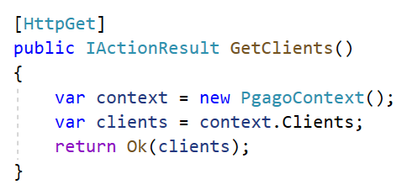
Simple select query
Following code:
Opens connection to db
Generate SELECT statement
Parses the result
Closes the connection to db

Slide 29
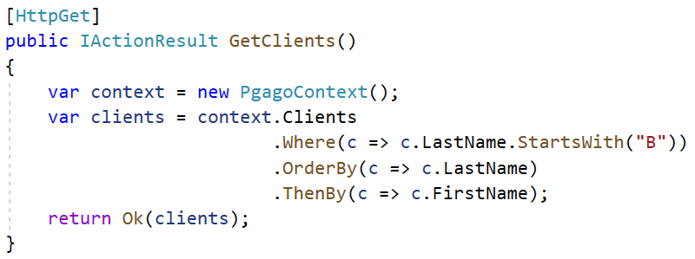
Select query
DbSet<T> implements Ienumerable<T> which means we can use our Linq knowledge to create more complex SQL query.

Slide 30
Select query
Remember that not every Linq can be translated into SQL. You may get an exception similar to „We do not know how to translate your LINQ into SQL code”.

Slide 31
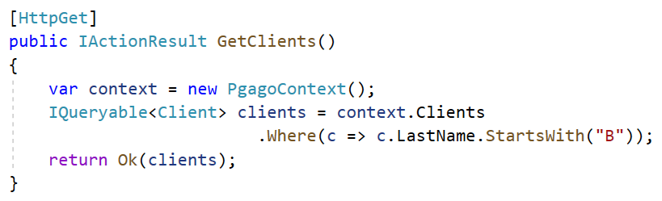
Select query – when the query is executed
We have to remember that our code is executed in a „lazy way”.
The return value from a Linq query on a DbSet<T> is of following type:

Slide 32
IQueryable<T>
The IQueryable interface inherits the IEnumerable interface so that if it represents a query, the results of that query can be enumerated.
Enumeration causes the expression tree associated with an IQueryable object to be executed.
The definition of "executing an expression tree" is specific to a query provider.

Slide 33
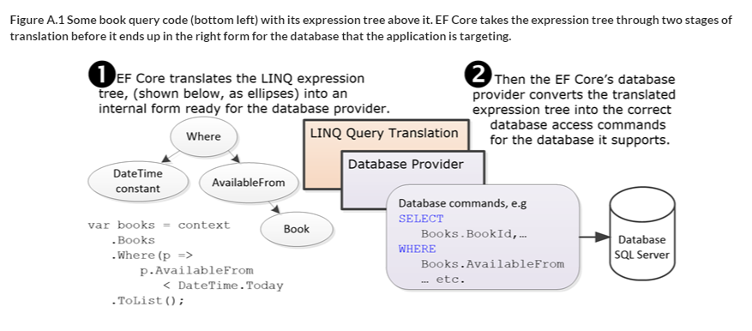
Expression trees

Slide 34
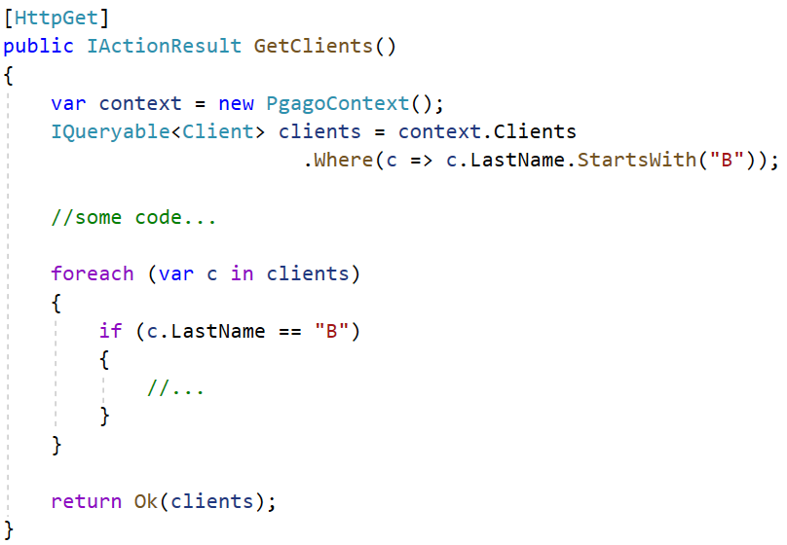
When the query is executed?

Slide 35
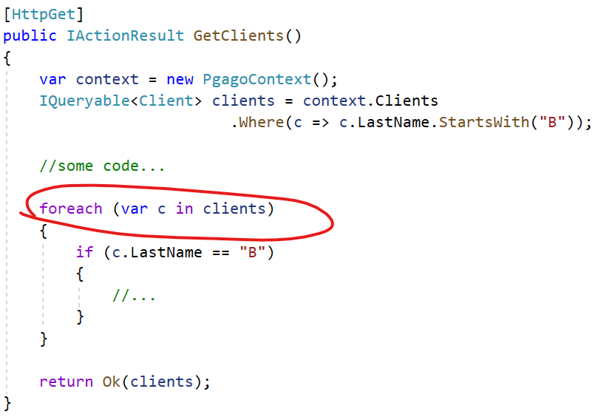
When the query is executed?

Slide 36
Eager loading
We can force the query to be executed immediately by using following methods.
.ToList()
.ToListAsync()
.Single()
.SingleAsync()
.First()
.FirstAsync()

Slide 37
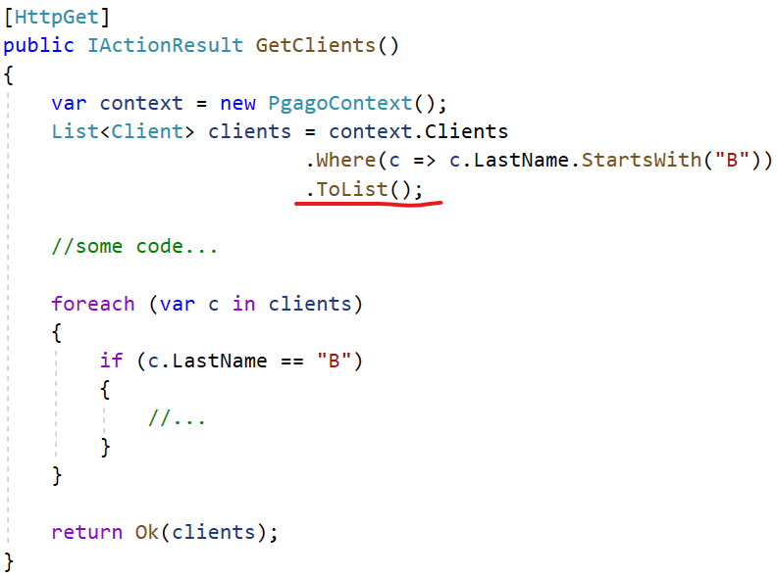
Eager loading

Slide 38
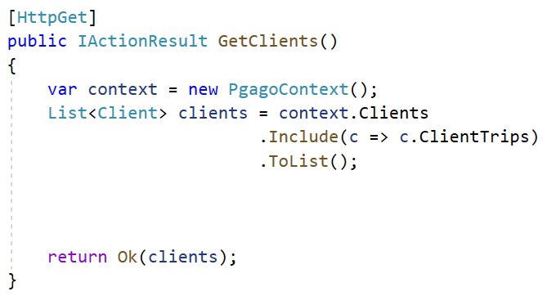
Select - join

Slide 39
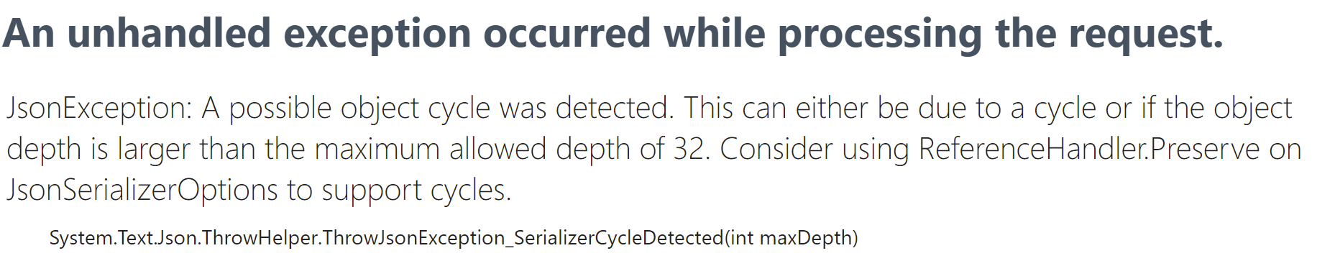
Cycle problem during serialization

Slide 40
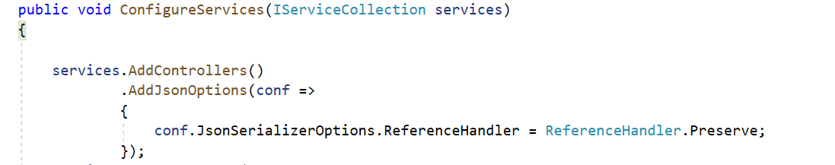
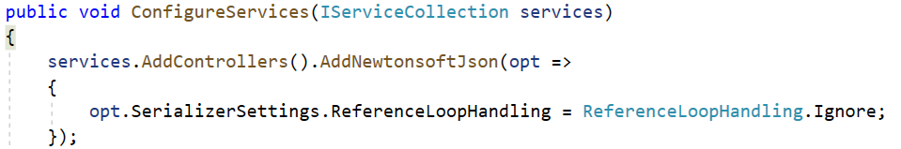
Cycle problem during serialization
System.Text.Json.JsonSerializer doesn’t have a way to simply ignore circular references, whereas Newtonsoft does.
Add Nuget package Microsoft.AspNetCore.Mvc.NewtonsoftJson

Slide 41
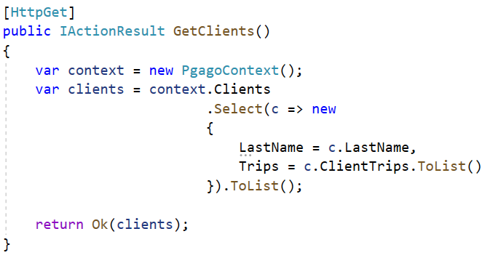
Select – projection query

Slide 42
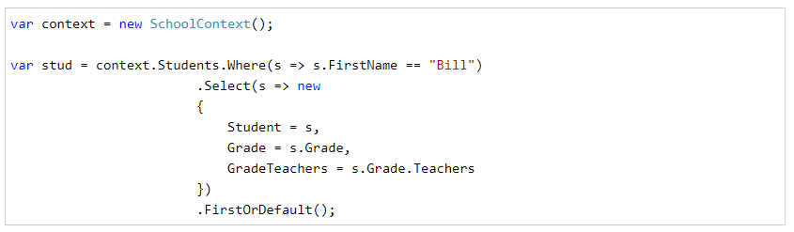
Select – projection query
We can also load multiple related entities by using the projection query instead of Include() or ThenInclude() methods. The following example demonstrates the projection query to load the Student, Grade, and Teacher entities.

Slide 43
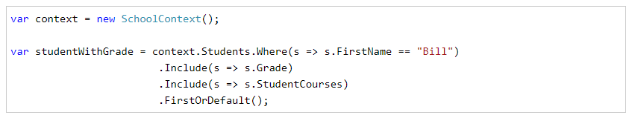
Multiple Include
Use the Include() method multiple times to load multiple navigation properties of the same entity. For example, the following code loads Grade and StudentCourses related entities of Student.

Slide 44
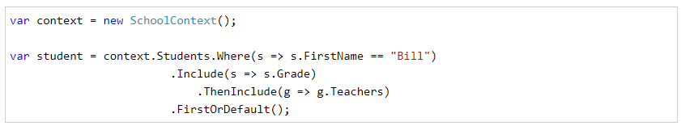
ThenInclude
EF Core introduced the new ThenInclude() extension method to load multiple levels of related entities. Consider the following example:
In the above example, .Include(s => s.Grade) will load the Grade reference navigation property of the Student entity. .ThenInclude(g => g.Teachers) will load the Teacher collection property of the Grade entity. The ThenInclude method must be called after the Include method. The above will execute the following SQL queries in the database.

Slide 45
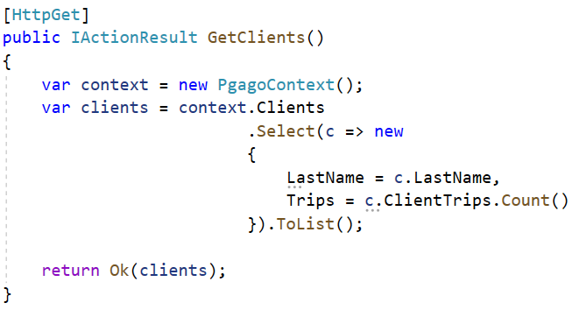
Select – using subqueries

Slide 46
Select – using subqueries
SELECT [c0].[LastName], (
SELECT COUNT(*)
FROM [trip].[Client_Trip] AS [c]
WHERE [c0].[IdClient] = [c].[IdClient]) AS [Trips]
FROM [trip].[Client] AS [c0]

Slide 47
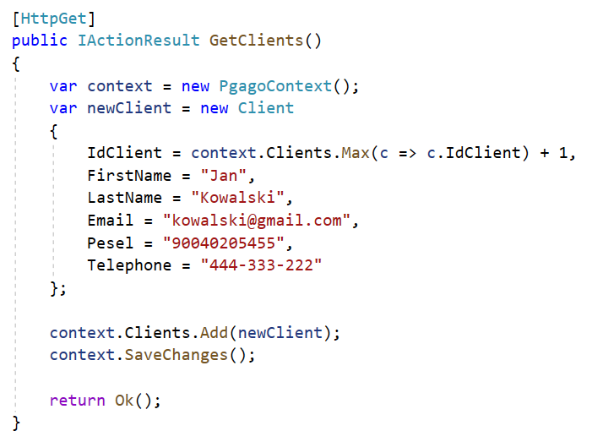
Insert
SaveChanges() wraps all the queries into
a single transaction. In this example we will send a single
Insert statement

Slide 48
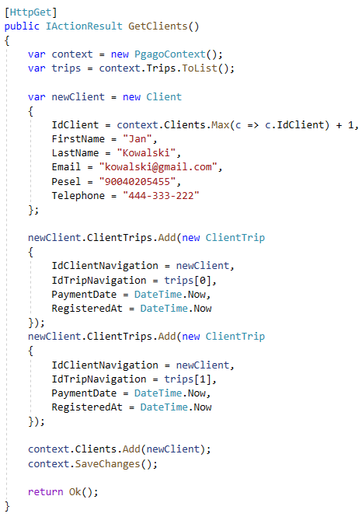
Insert – complex example

Slide 49
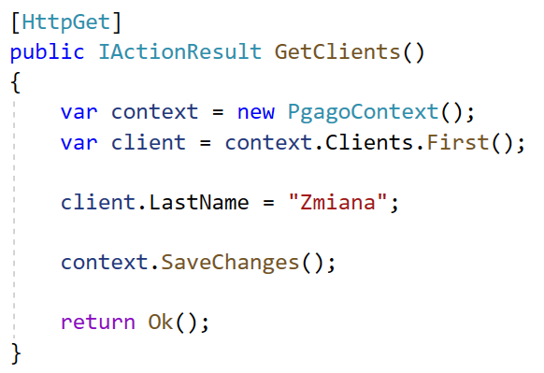
Update
When updating entities – we are often using change tracking.
DbContext tracks all the objects that we fetched through DbSet<T> objects
UPDATE [trip].[Client] SET [LastName] = @p0
WHERE [IdClient] = @p1;
SELECT @@ROWCOUNT;

Slide 50
Update Data in Disconnected Scenario in Entity Framework Core
EF Core API builds and execute UPDATE statement in the database for the entities whose EntityState is Modified. In the connected scenario, the DbContext keeps track of all entities so it knows which are modified and hence automatically sets EntityState to Modified.
In the disconnected scenario such as in a web application, the DbContext is not aware of the entities because entities were modified out of the scope of the current DbContext instance. So, first we need to attach the disconnected entities to a DbContext instance with Modified EntityState.

Slide 51
ChangeTracker in Entity Framework Core
The DbContext in Entity Framework Core includes the ChangeTracker class in Microsoft.EntityFrameworkCore.ChangeTracking namespace which is responsible of tracking the state of each entity retrieved using the same DbContext instance. It is not intended to use it directly in your application code because it may change in future versions. However, you can use some methods for tracking purpose.

Slide 52
ChangeTracker in Entity Framework Core
The ChangeTracker class in Entity Framework Core starts tracking of all the entities as soon as it is retrieved using DbContext, until they go out of its scope. EF keeps track of all the changes applied to all the entities and their properties, so that it can build and execute appropriate DML statements to the underlying data source.

Slide 53
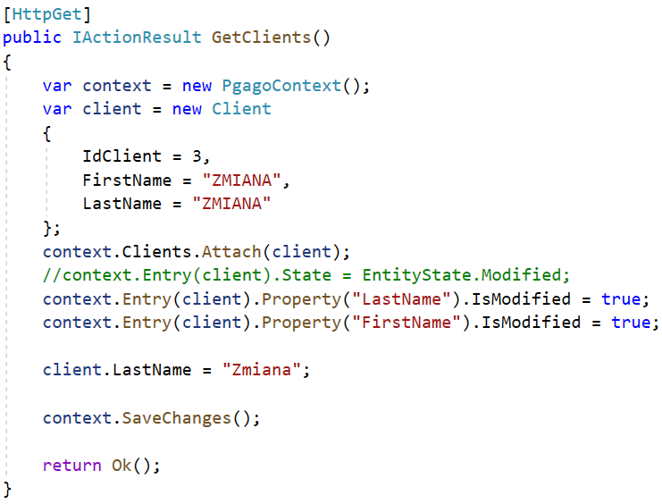
Update – setting the state manually

Slide 54
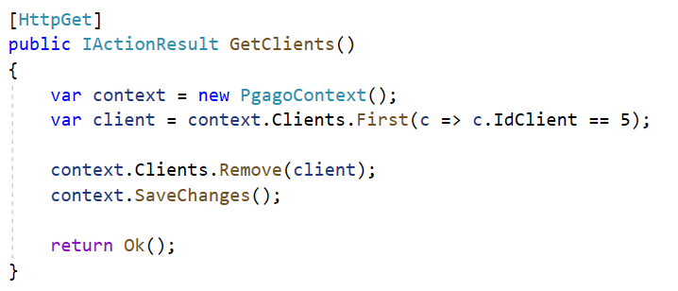
Delete

Slide 55
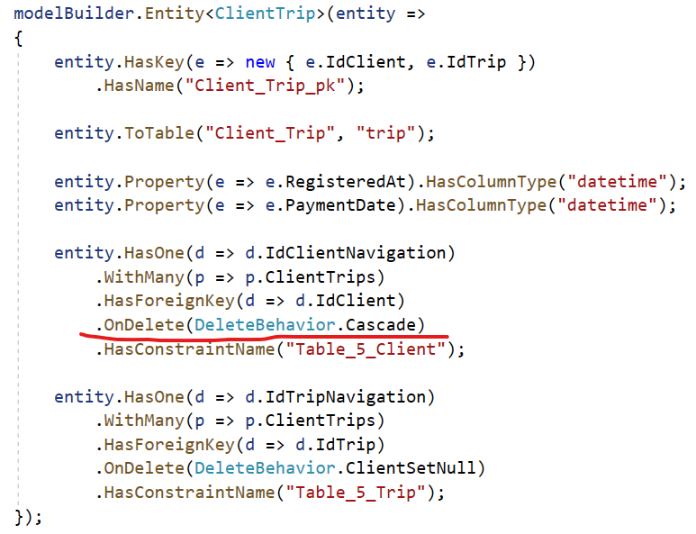
Delete - relationship configuration

Slide 56
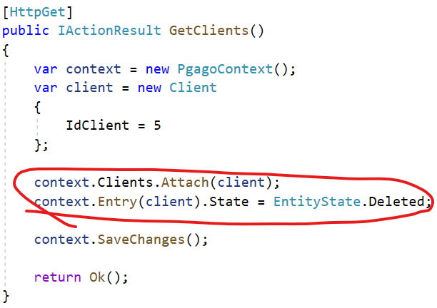
Delete without additional fetch

Slide 57
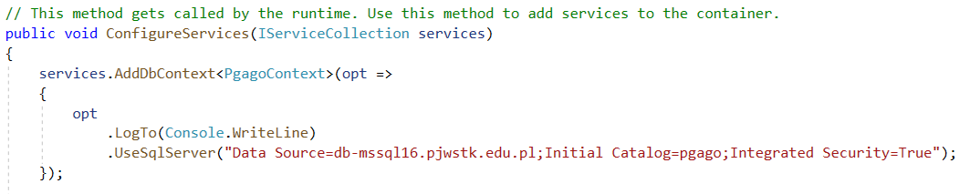
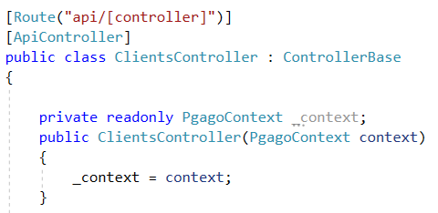
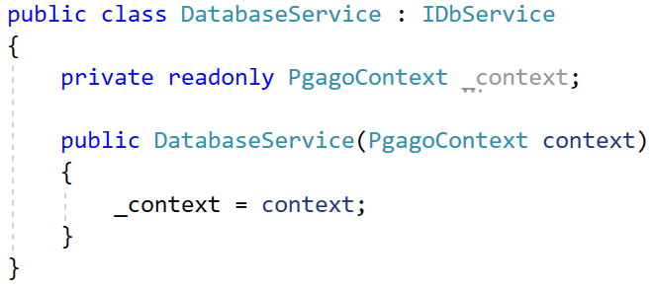
Injecting DbContext

Slide 58
Using DTOs, custom models
Often we need to pass into endpoint set of parameters which do not fit any database-related model. In other situations we would like to return a custom model which includes a set of fields combined from multiple tables.

Slide 59
DTO – Data Transfer Object
A Data Transfer Object is an object that is used to encapsulate data and send it from one subsystem of an application to another.
DTOs are most commonly used by the Services layer in an N-Tier application to transfer data between itself and the UI layer.

Slide 60
Bibliography
https://docs.microsoft.com/pl-pl/ef/core/managing-schemas/scaffolding?tabs=dotnet-core-cli
https://docs.microsoft.com/pl-pl/ef/core/cli/dotnet
https://www.learnentityframeworkcore.com/
https://www.entityframeworktutorial.net/efcore
https://livebook.manning.com/book/entity-framework-core-in-action/a-a-brief-introduction-to-linq/v-11/13
https://docs.microsoft.com/pl-pl/ef/core/querying/related-data/eager
https://www.entityframeworktutorial.net/efcore/querying-in-ef-core.aspx

